Slide 1
Work Form
Name
Institution / Title
Mail
Category
Due date
Publisher
Journal
Image size
: John Doe
: Science Uninersity / Ph.D
: 000@000.000
: Journal Cover
: 20XX / XX / XX
: Royal Society Of Chemistry
: Journal of Material Chemistry B
: 215mm wide x 159mm high
(2539 pixels wide x 1878 pixels high)

Slide 2
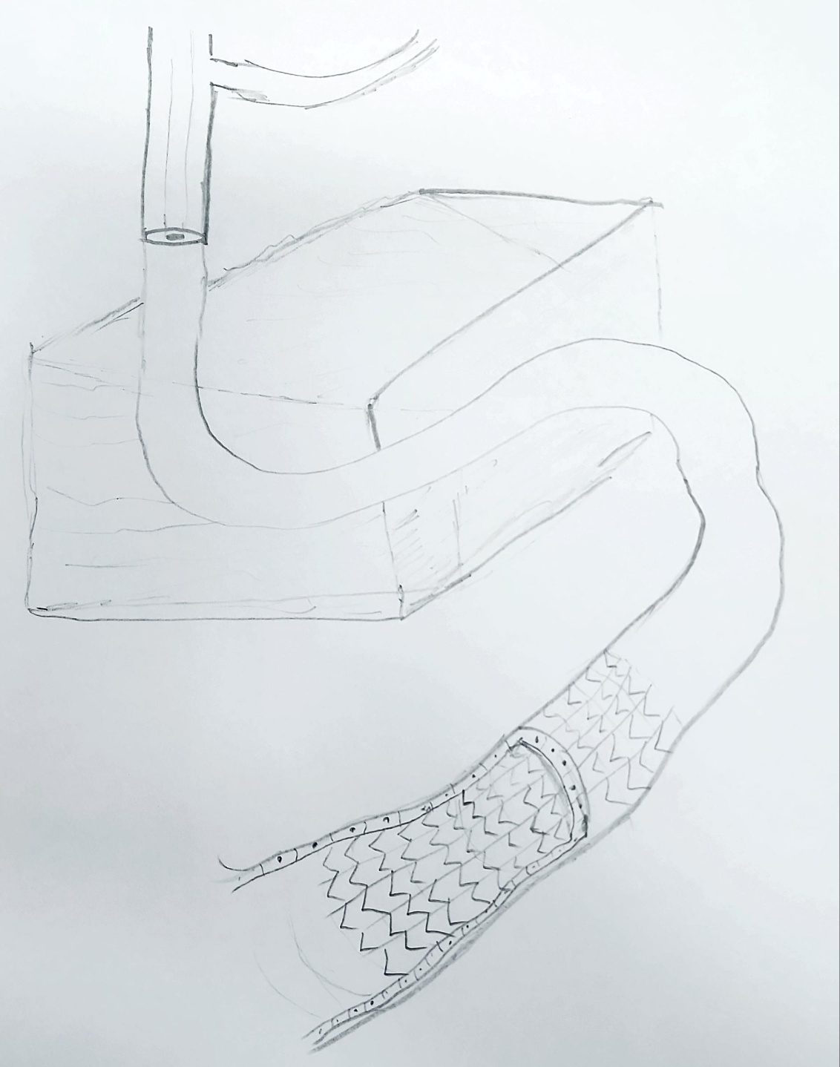
priority is
SKETCH & SUMMARY
This study developed an in-bath bioprinting method to print a human coronary artery-like vessel with an endothelial monolayer (inner layer of artery). This vessel is compatible with cardiovascular stents and it can be used as an in vitro testing model to advance the stent discovery.
The cover image requested includes the following concepts:
Support bath assisted coaxial bioprinting
Endothelium monolayer
Cardiovascular Stent
1
2
1 = Coaxial Nozzle
2 = Endothelium
3 = Cardiovascular stent
3

Slide 3
Detail
1 = Coaxial Nozzle
2 = Support Bath
3 = Bath container
4 = Endothelium
5 = Cardiovascular stent
1
3
2
4
5

Slide 4
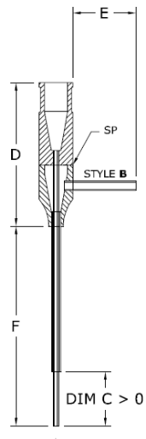
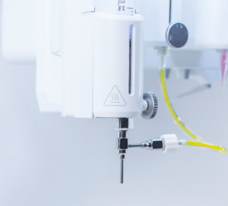
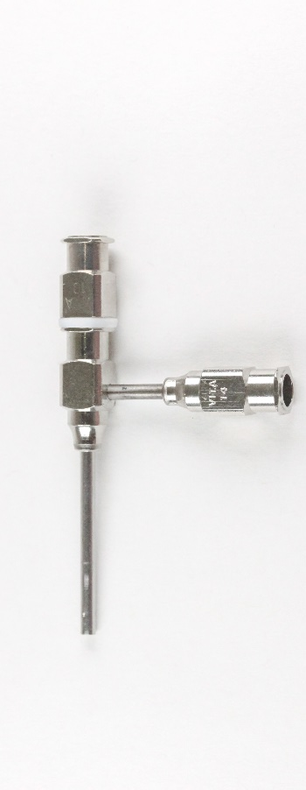
Reference
1. Coaxial Nozzle
Coaxial Nozzle
Coaxial Nozzle
Attached with bioprinter

Slide 5
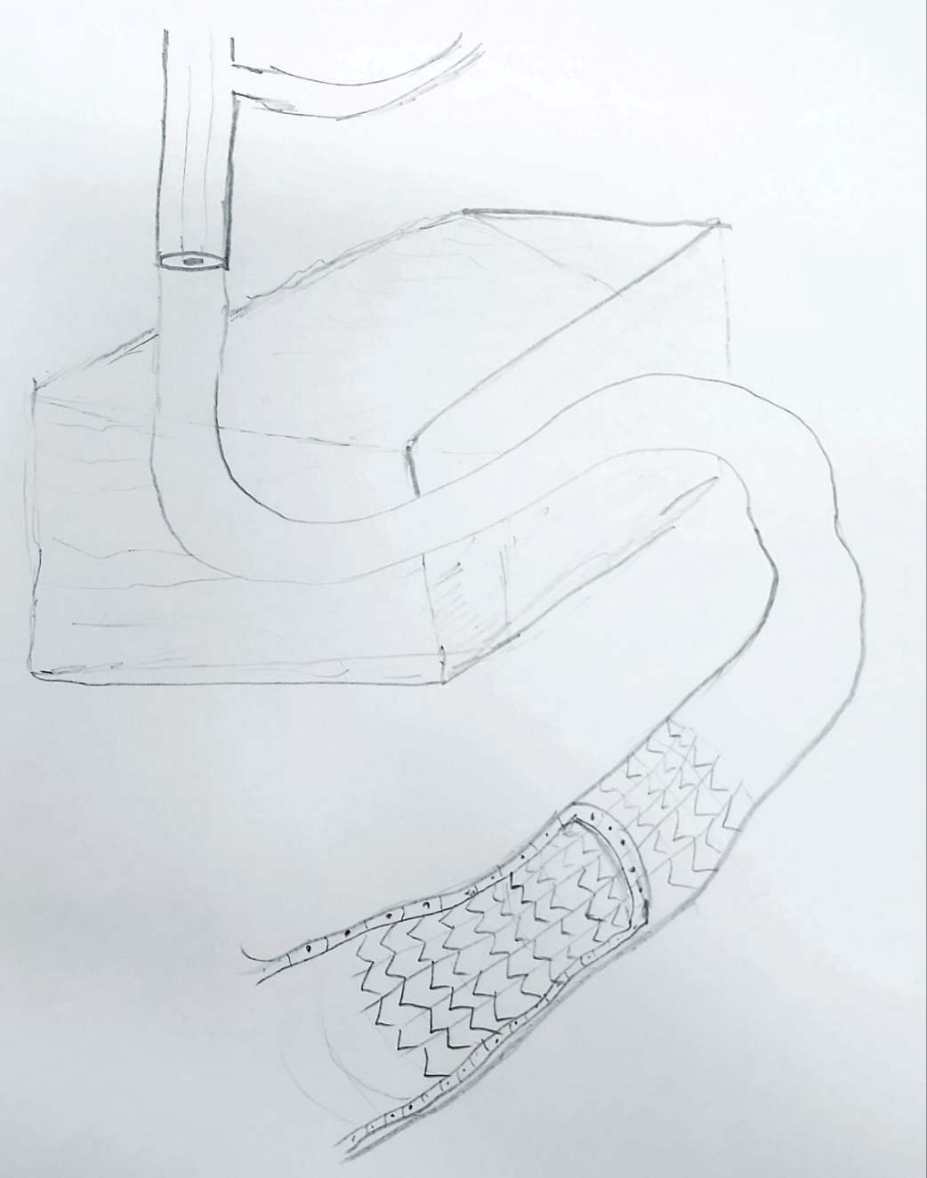
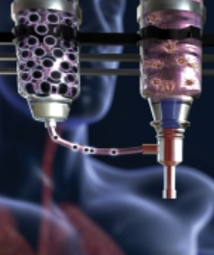
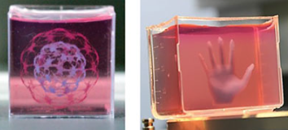
Reference
2,3. Support Bath
- Two different color materials Coaxially extruding into support bath
After passing through the bath material a blood vessel like tube emerges out of bath container.
A light green transparent support bath material can look like this in which the coaxial nozzle is extruding the material.

Slide 6
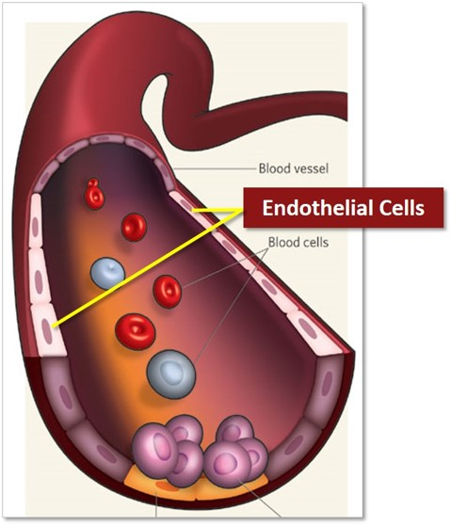
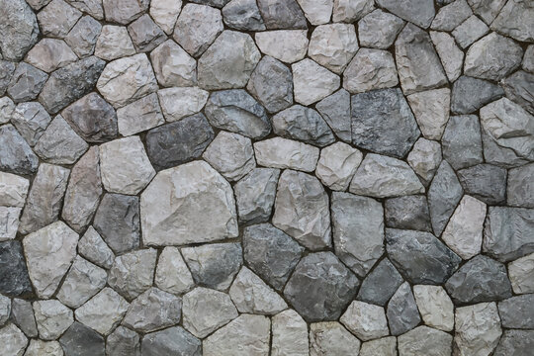
Reference
4. Endothelium
Cobblestone Morphology
Cross sectional view of artery

Slide 7
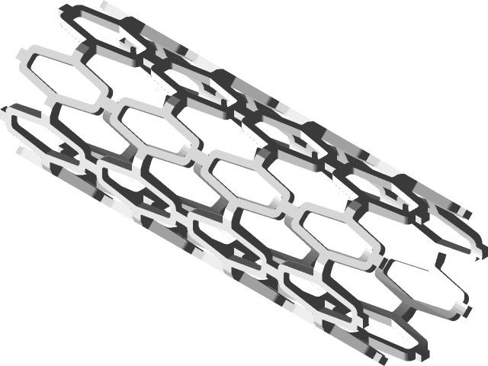
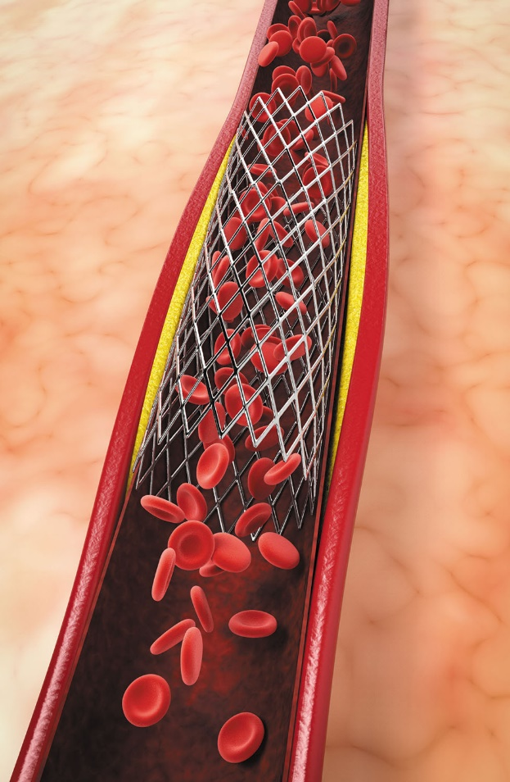
Reference
5. Cardiovascular stent
Cardiovascular Stent
Stent inside artery

Slide 8
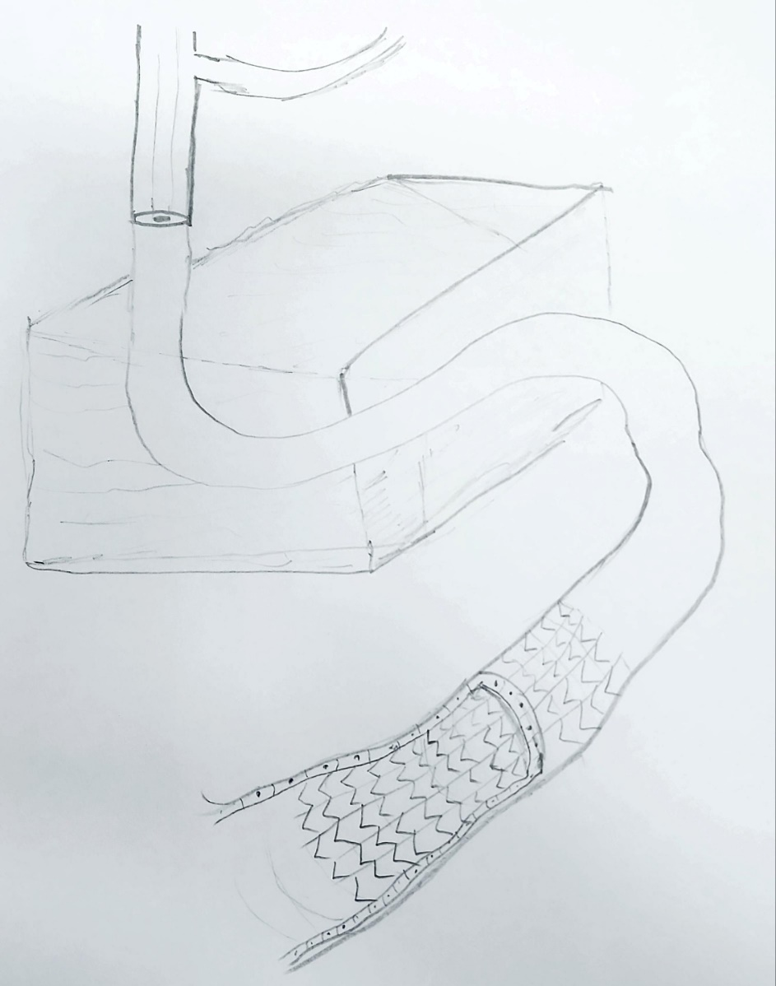
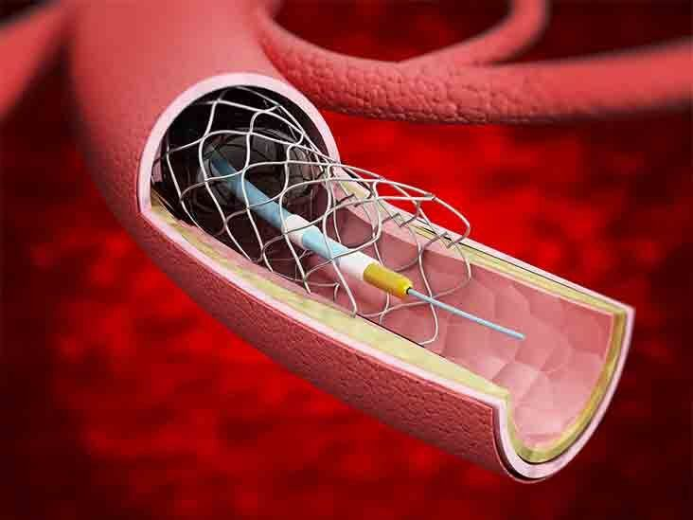
Reference
6. Stentable blood vessel
A cut view of blood vessel can look like this
A balloon catheter would be nice to add, although it's not strictly necessary.
The cut view should show
Show a single cell layer of cells (endothelium) lining the lumen of blood vessel.
A cardiovascular stent placed inside the blood vessel

Slide 9
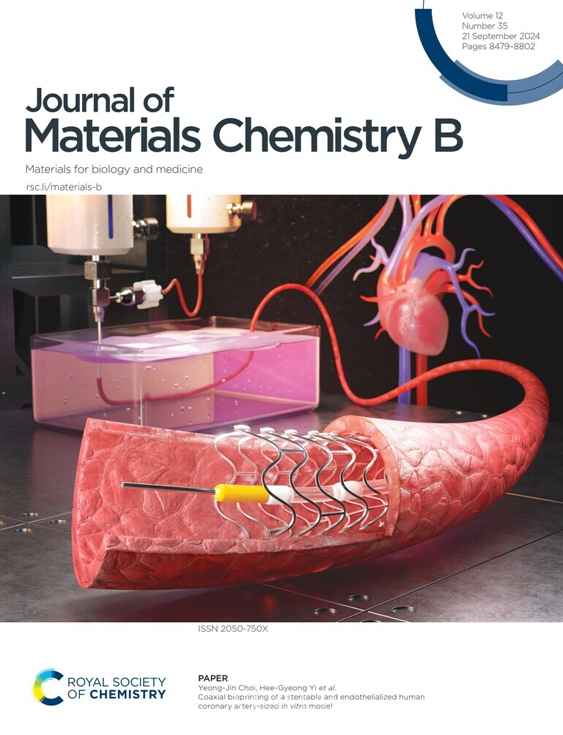
After further work, a cover image was completed.

Slide 10
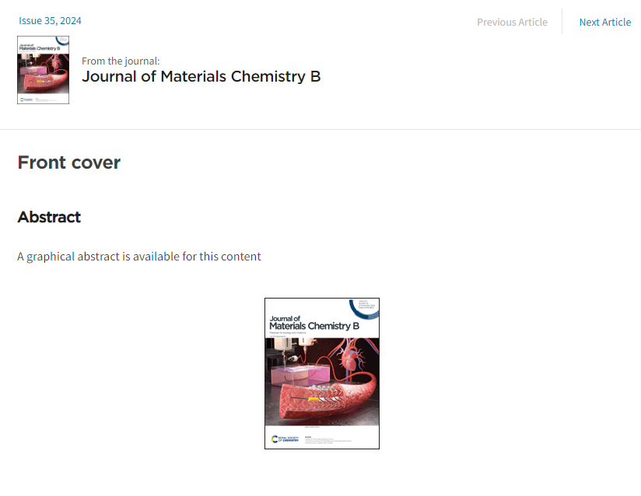
It was selected as the cover
for the September 2024 issue of the journal.
https://pubs.rsc.org/en/content/articlelanding/2024/tb/d4tb90142h

